Slide 1
Campaign Results

Slide 2
Goal
Increase sales by 10% by the end of Q1 with the launch of the new website
Campaign Objective:
Traffic/Conversion
KPI:
Number of website clicks (Conversion Rate)

Slide 3
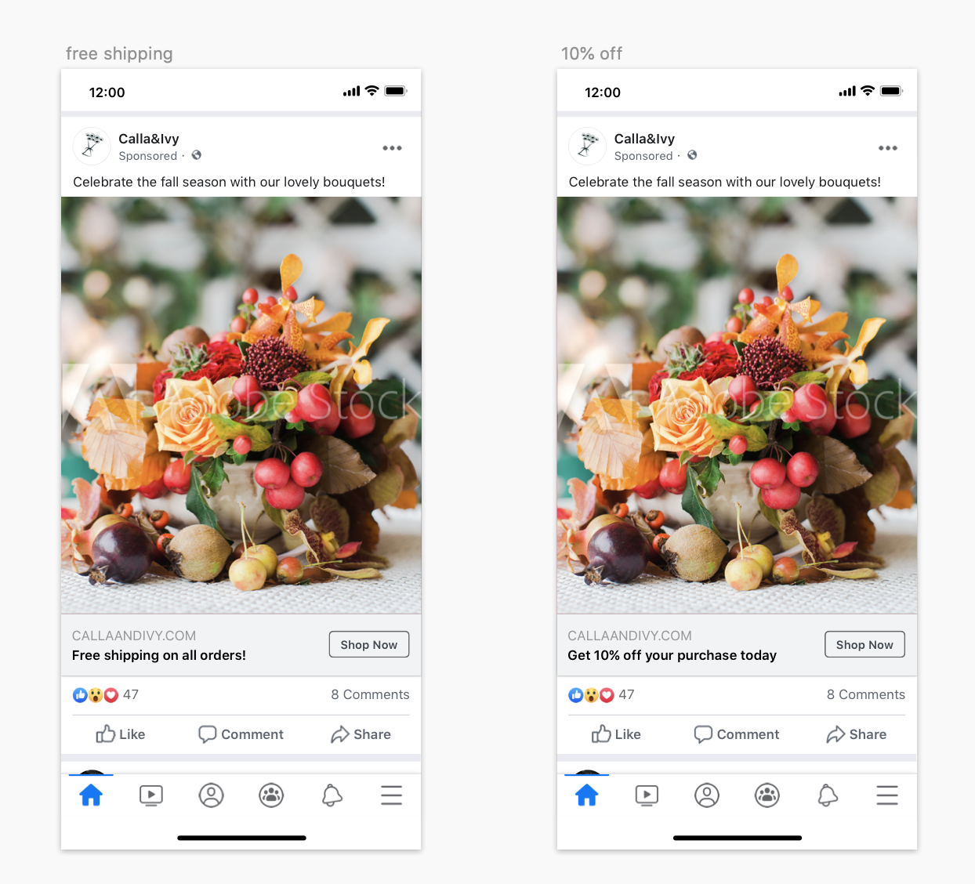
Creative
Assets
Copy
Image of product
Call to Action

Slide 4
Campaign
Settings
Objective:
Traffic/Conversion
Audience: (Custom Audience)
Women aged 24-55 years old
Interested in cut flowers
Located in Amsterdam
Placement:
Facebook, Instagram and Audience Network
Duration:
November 6, 2020 - December 15, 2020
Budget:
$100 daily for both campaigns for 39 days.
$3900 for the whole advertising period.

Slide 5
Results
Campaign Result
The Free shipping campaign received 38,790 link clicks.
2% of the visits to the website resulted in a purchase.
People spend $40 in every purchase.
Campaign Cost
Total cost: $2974.50 (including A/B test cost)
ROAS: 10.8
Revenue
807 people made a purchase.
40,350 Link clicks (2% resulted in a purchase)
Total Investment
Advertising: $2974.50
Cost: $15 per sold item
Total Investment: Cost of goods + cost of advertising = 15079.50
ROI: 1.14

Slide 6
Results
A/B Testing was used to evaluate which promotion will help reach our campaign objective.
The ‘Free shipping’ promotion was the campaign winner and had the lowest CPR of $0.08.
The free shipping campaign received a 73.8k Reach and 86.4k Impressions.
The A/B test winner had a 95% chance that the results would be the same.
The amount spent on the 10% off campaign was almost the same with less results meaning it would not be an effective use of the advertising budget to go with the 10% campaign.
WINNER
Image placeholder
Image placeholder

Slide 7
Conclusion & Next Steps
Continue to find ways to keep optimising advertisements to reduce costs.
Promotions with ‘free shipping’ rather than a discount are more effective.
The ad creative of the product (bouquet of flowers) was well received.
Offering ‘free shipping’ in the first quarter of the year for fall is beneficial for Calla and Ivy and attracted more sales.
Calla and Ivy were able to cover the cost of the campaign and improved sales.

Slide 8
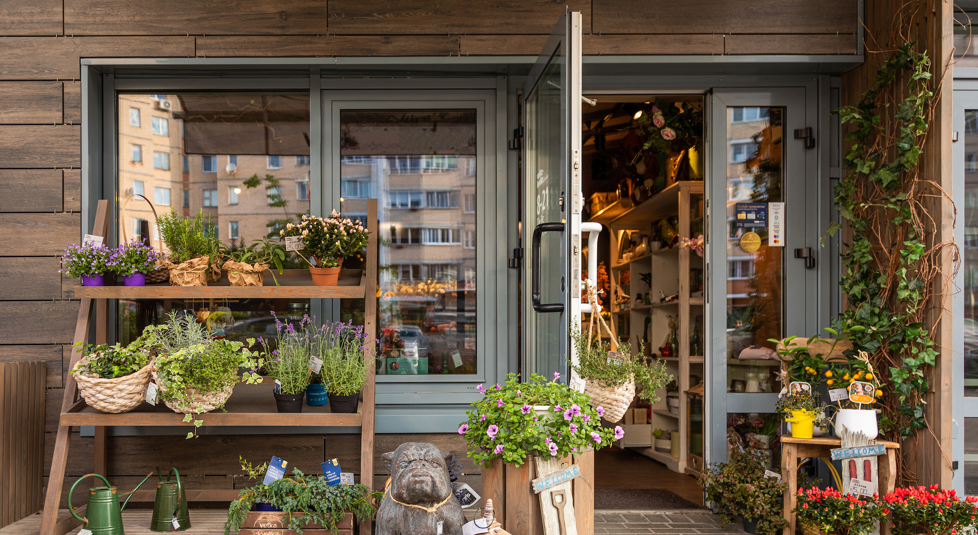
Thank
You!
Image placeholder

